Slide 1




Obtaining ethics approval for the cmRCT design from 31 ethics committees in 4 countries:
a challenge?
39
5
Linda Kwakkenbos, PhD
Post-doctoral fellow, Dept. of Psychiatry, McGill University,
Co-Director, Scleroderma Patient-centered Intervention Network
Guest Rearcher, Behavioural Science Institute, Radboud University,
Notes:
Canada, US, UK, France, Mexico

Slide 2
The short answer is:

Slide 3



The Scleroderma Patient-centered Intervention Network (SPIN)

Slide 4
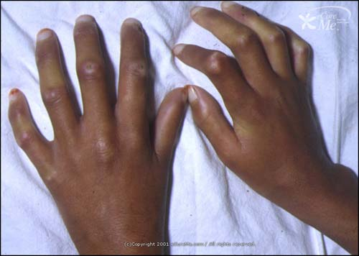
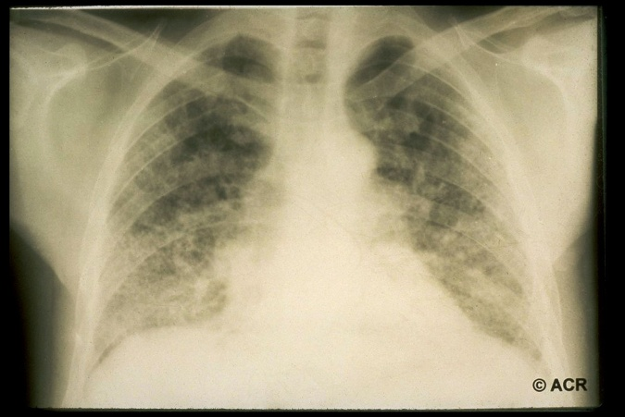
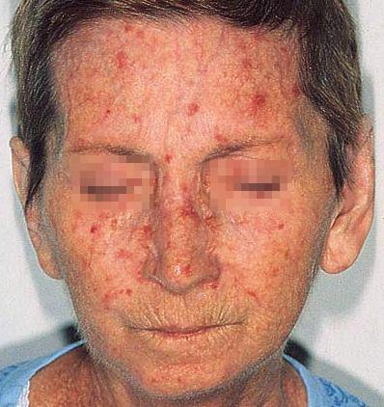
Scleroderma
Derived from Greek words scleros (hard) and derma (skin)
Autoimmune changes, abnormal fibrosis (“scar tissue”), vascular problems
Rare disease: approx. 1500 patients in the Netherlands; 240 per million in the US

Slide 5
Treatment of scleroderma
Complex
Focus on reducing symptoms, improving physical function and health-related quality of life
Potential for non-pharmacological interventions (educational, psychosocial and rehabilitation)
→ In chronic diseases, patient-centered care consists of a combination of pharmacological and non-pharmacological interventions

Slide 6
What about rare diseases?
Typically no access to psychosocial and rehabilitation interventions that are:
    Specific to needs of people with the disease
    Adequately tested to determine if useful

Slide 7
Why?
Few (specialized) centers treat enough patients with a rare disease to:
  Develop and sustain disease-specific psychosocial and rehabilitation service
  Conduct large enough trials of disease-specific interventions
Health care providers in local settings generally have little or no experience with a rare disease and specific needs of patients

Slide 8

SPIN Aims
To develop psychosocial and rehabilitation interventions that are accessible, cost-effective, and can be delivered on an ongoing basis to people living with scleroderma
To develop a sustainable infrastructure to conduct multiple high-quality trials of interventions

Slide 9
SPIN – Key components
Patient organization partnerships throughout the research process and as end user
International network of clinical research centers
Virtually delivered interventions
Cohort multiple RCT (cmRCT) design in rare disease context

Slide 10




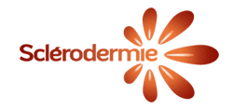



SPIN: Patient organizations

Slide 11
SPIN: Patient organizations
Represented in SPIN Steering Committee and Patient Advisory Board
Understand and very much like the cmRCT design:
  No disappointment for patients not receiving intervention
  A sustainable framework for multiple trials: doing what no-one has been able to do
  The “ethical” alternative isn’t an option: calling patients that they were eligible for an intervention but cannot get it

Slide 12
SPIN: Patient perspective
Challenges:
Some patients express “SPIN Cohort fatigue” – how long can someone be enrolled before the trials start?
  Removed some questionnaires from the assessments
  Regular updates through Cohort platform and patient magazines
We cannot speak about the 4 interventions (control group should not be aware of intervention):
  Address by describing a range of interventions that we could be doing: “These programs will focus on problems important to patients, such as fatigue, hand function and mobility, sleep problems, emotions and stress, concerns about appearance, pain, coping with scleroderma, nutrition, and exercise.”

Slide 13
SPIN – Key components
Patient organization partnerships throughout the research process and as end user
International network of clinical research centers around the world
Virtually delivered interventions
Cohort multiple RCT (cmRCT) design in rare disease context

Slide 14
SPIN – Key components
Patient organization partnerships throughout the research process and as end user
International network of clinical research centers around the world
Virtually delivered interventions
Cohort multiple RCT (cmRCT) design in rare disease context

Slide 15
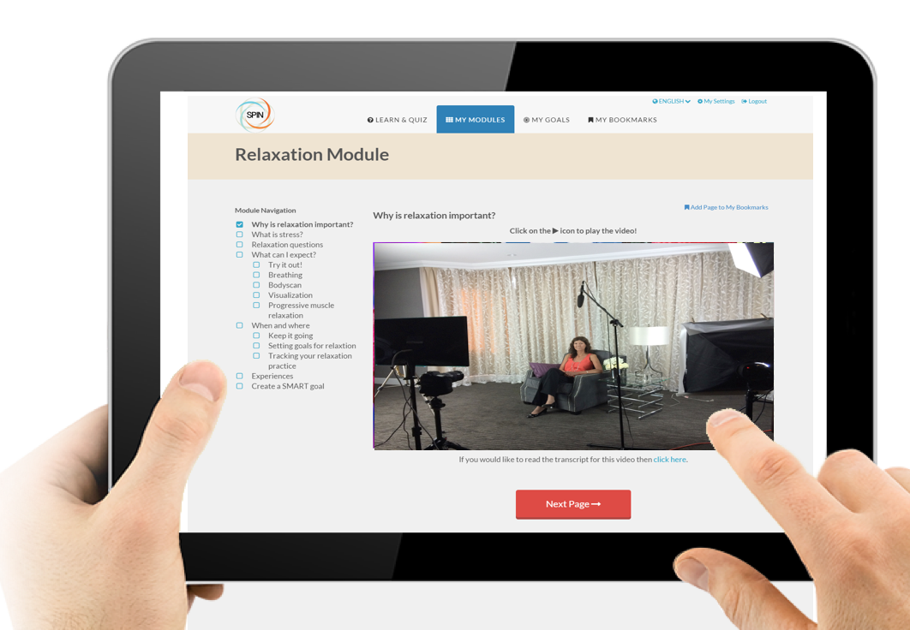
Self-guided eHealth interventions:
Hand exercises (SPIN-HAND)
Disease self-management (SPIN-SM)
Emotional distress (SPIN-ED)
Appearance-related concerns (SPIN-BI)

Slide 16
SPIN – Key components
Patient organization partnerships throughout the research process and as end user
International network of clinical research centers
Virtually delivered interventions
Cohort multiple RCT (cmRCT) design in rare disease context

Slide 17
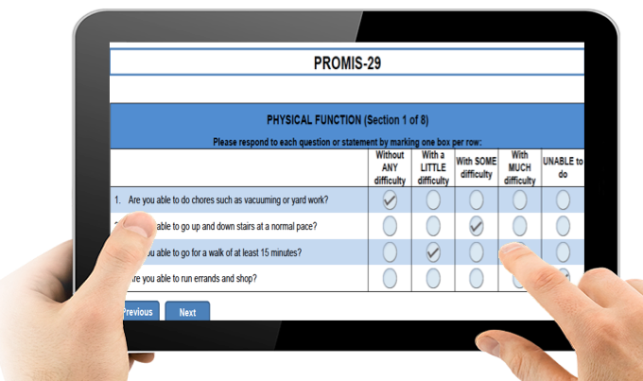
The SPIN Cohort
Physician completes medical data form
Patient completes online questionnaires every 3 months
  Timeframe chosen based on primary endpoint trials
  Insight in problems important to patients
  Measurement-related studies: e.g., validation of questionnaires, comparing equivalence of translations

Slide 18
SPIN’s cmRCT: a ‘consented Zelen’ design?
Consent for enrolment in cohort
+ consent for trial elements
Identification of eligible participants
Random allocation
Experimental treatment
Standard treatment
Consent given
Consent withheld
Experimental treatment
Standard treatment
Standard treatment
Included in ITT analysis

Slide 19
SPIN consent for Cohort participation
We will use your responses from the questionnaires that you will complete as part of the SPIN Cohort for the following purposes:
To gain a better understanding of problems that may be important to people living with scleroderma, to determine the best way to evaluate the nature of these problems, and to plan for interventions to address these problems;
To determine eligibility of SPIN Cohort participants for supportive interventions that SPIN will develop;
To compare results of the questionnaires between people in the SPIN Cohort who receive an intervention in the future and members of the SPIN Cohort who do not receive that particular intervention.

Slide 20
SPIN consent for Cohort participation (2)
Therefore, currently, as part of your participation in the SPIN Cohort, we are asking your permission;
to allow your rheumatologist or a member of your rheumatologist’s staff to provide your contact information (email address, phone number) to SPIN investigators, as well as some basic information related to your scleroderma (e.g., disease subtype, date of onset disease) that can be obtained from your medical chart;
for SPIN investigators to contact you via email (with a follow-up phone call if no response to emails) at regularly scheduled 3-month intervals to invite you to complete a series of questionnaires related to problems that may be important to many people with scleroderma, for example, but not limited to fatigue, hand function, sleep problems, and emotional distress;
to allow SPIN investigators to use your data along with data provided by other SPIN Cohort participants to better understand problems that may be important to people with scleroderma;

Slide 21
SPIN consent for Cohort participation (3)
in the future, once SPIN online interventions are developed, to use responses to SPIN Cohort questionnaires to determine if you have concerns that are the focus of a SPIN research intervention and to contact you to invite you to participate in one or more of SPIN’s interventions. Note that only a limited amount of SPIN Cohort participants who are potentially eligible to participate in a given SPIN intervention will have the opportunity to participate in the SPIN intervention. Only SPIN Cohort participants who are selected to be offered the intervention will be contacted about the intervention. Also, note that at the present time, you are providing consent only to participate in the SPIN Cohort, and you are not giving consent to participate in any SPIN intervention. If you become eligible for one of SPIN’s tests of its interventions, you will be contacted at a later date and invited to participate.
in the future, to compare your responses on SPIN Cohort questionnaires to the responses of people in the SPIN Cohort who participated in an intervention in which you did not participate.

Slide 22
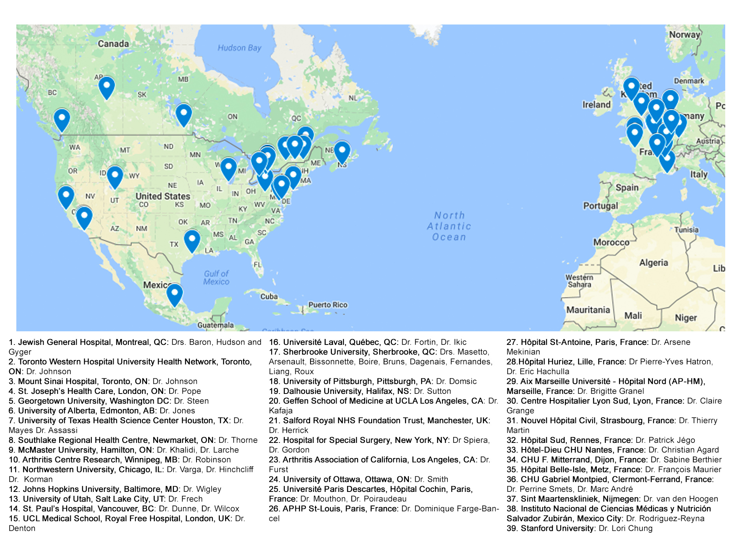
SPIN Recruiting sites

Slide 23
SPIN Cohort
Enrolment started April 2014
Currently N = 1314 active participants
N = 246 withdrawals (no time; too ill to participate/ deceased; no computer access; other reason)
Patients complete measures in English, French or Spanish
Canada, US, UK, France, Mexico

Slide 24
39 ethics committees…

Slide 25
Experiences: optional consent components?
“It is stated that participants will be asked to consent to being contacted about potentially participating in SPIN interventions that may be offered to cohort participants in the future. Please ensure that this is described and is an optional component in the consent form (e.g. include as a yes/no check box prior to the consent signing section.)”
Response: SPIN is using a trial model called the cohort multiple randomized controlled trial (cmRCT) design (see Relton et al., BMJ, 2010). It has the advantage of being able to collect longitudinal data, as well, on important problems, but the ability to offer patients interventions once they are developed is a key component of the model. Thus, patients who wish to do only the longitudinal data collection, but not be contacted if they are eligible for any of the online psychosocial and rehabilitation interventions that SPIN will develop, should not enroll. We have made sure that this is clearly stated in the consent form and that patients are aware of their options. In the revised consent form, the components of consent appear in a list-wise format. We have not included a checkbox by each one, however, as this would be confusing and suggest that patients may consent to some elements and not others and still enroll.

Slide 26
Experiences: optional consent components?
As part of my participation, I agree with all elements listed below:
to share my email address and telephone number with the head office of SPIN, at the Jewish General Hospital, in Montreal, Quebec, Canada.
to be contacted by SPIN periodically to complete SPIN Cohort questionnaires on the Internet, and
to be contacted by SPIN investigators to inquire about my interest in participating in SPIN interventions that may be offered in the future.

Slide 27
Experiences: duration of the study?
Have you defined a primary study endpoint for this study?
Response: Not applicable. The SPIN Cohort is an ongoing observational registry that is intended to gain more knowledge on psychological issues in scleroderma, the best way to measure outcomes related to this, and how to address these issues. Over time, it is anticipated that multiple research questions will be addressed using SPIN Cohort data using different datapoints. In the future, when trials are conducted within the SPIN Cohort framework, a study protocol will be submitted to the IRB and published, including a description of the primary endpoint for each trial.

Slide 28
Experiences: ethics boards/ enrolling sites cutting out consent elements
“…this study will use the Internet to collect data from people with scleroderma from many different sites in Canada, the USA, and Europe and, eventually, to develop and test interventions to support coping with living with scleroderma.”
“At regular 3-month intervals, you will be sent an email, prompting you to go online and fill out your SPIN Cohort questionnaires again. You might also receive e-mails reminding you to go online and fill out the forms if you do not complete your questionnaires after the initial email or a reminder phone call if you have not responded to emails.”

Slide 29
Experiences: ethics boards/ enrolling sites cutting out consent elements
Thus: we review every consent form and protocol before submission and after approval to ensure the cmRCT consent elements are still listed

Slide 30
Other considerations related to ethics:
All sites: continuing review (yearly renewal)
  We keep track, send the sites a notification and have standard letters to facilitate submission
Are we using the data that we are collecting?
“Flexible” cohort platform: adding and removing measures
  Would require going back to 39 sites with an amendment…
  But: it may be acceptable to submit a package of measures that will be included over time!

Slide 31

SPIN: Trials
Funding
  SPIN-HAND funded by the Arthritis Society
  SPIN-SM funded by the Canadian Institutes for Health Research (CIHR)
  “Bridge funding” from CIHR to keep Cohort going

Slide 32
Ethics for trials
Going back to 39 sites to obtain approval for each trial….

Slide 33
Ethics for trials
Going back to 39 sites to obtain approval for each trial….
OR....

Slide 34
Ethics for trials
“During your participation in the SPIN Cohort, you may also receive an email to ask you if you would like to try one of the internet-based research interventions that SPIN will develop. At that time, if you agree to do this, you will be contacted by a SPIN researcher with information about the intervention study, to obtain your informed consent, and to give you information on how to access the online intervention.”
(Except for France: their IRB requested to submit each trial)

Slide 35

Ethics approval for SPIN-HAND
Expedited review process: minimal risk intervention
Full-scale RCT submitted to our ethics committee: September 13, 2016
Approval obtained: September 20, 2016

Slide 36
Going forward…
SPIN-HAND trial (July 2017-March 2018): N = 440
  d=0.30; 80% power with α = 0.05, we will require data from ≥ 352 patients. Assuming 20% loss to follow-up, we would need to randomize 440 patients.
  Primary outcome: 3 months post-randomization
  Tracking usage of the intervention
SPIN-SM trial (April 2018 – Jan 2019): N = 440
Within 3-6 months, all SPIN Cohort participants will have been assessed for eligibility!

Slide 37
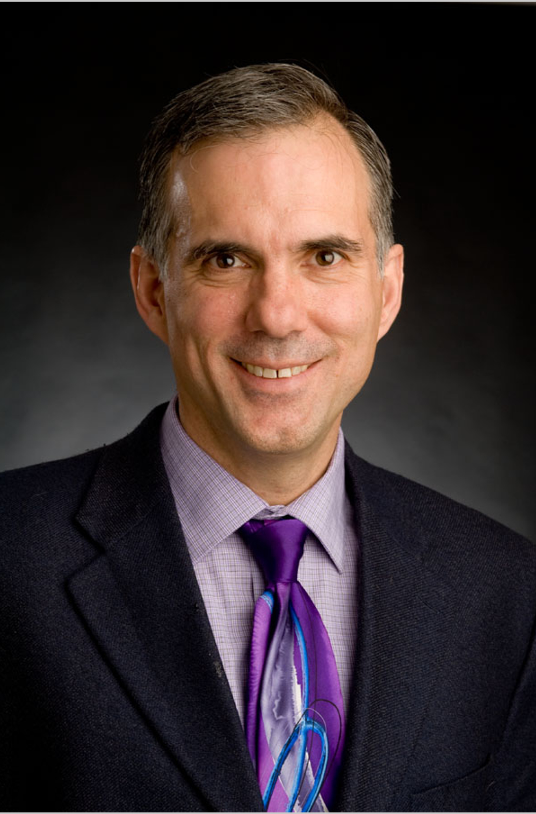
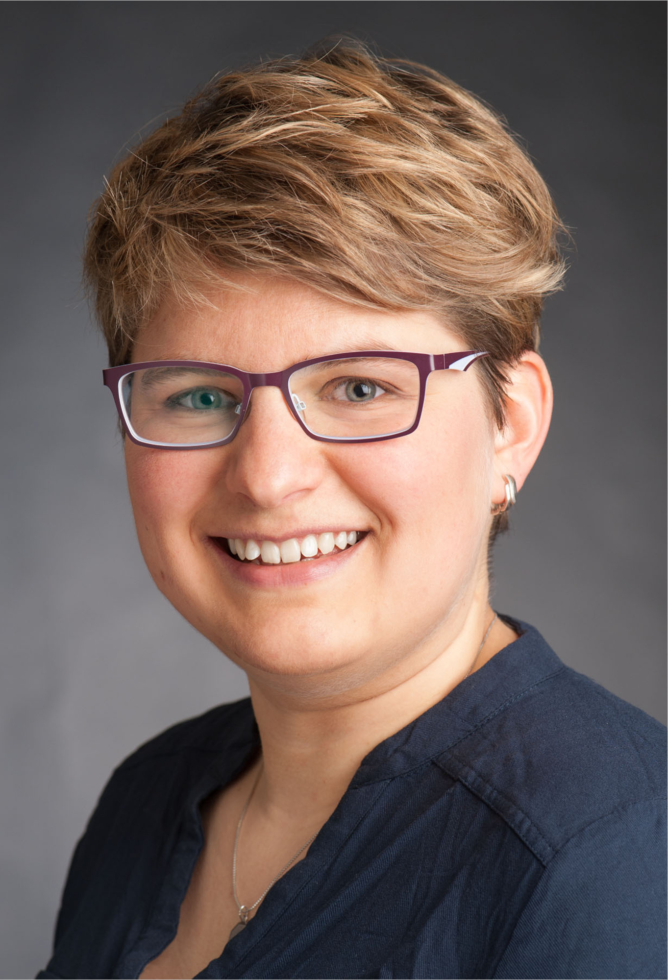
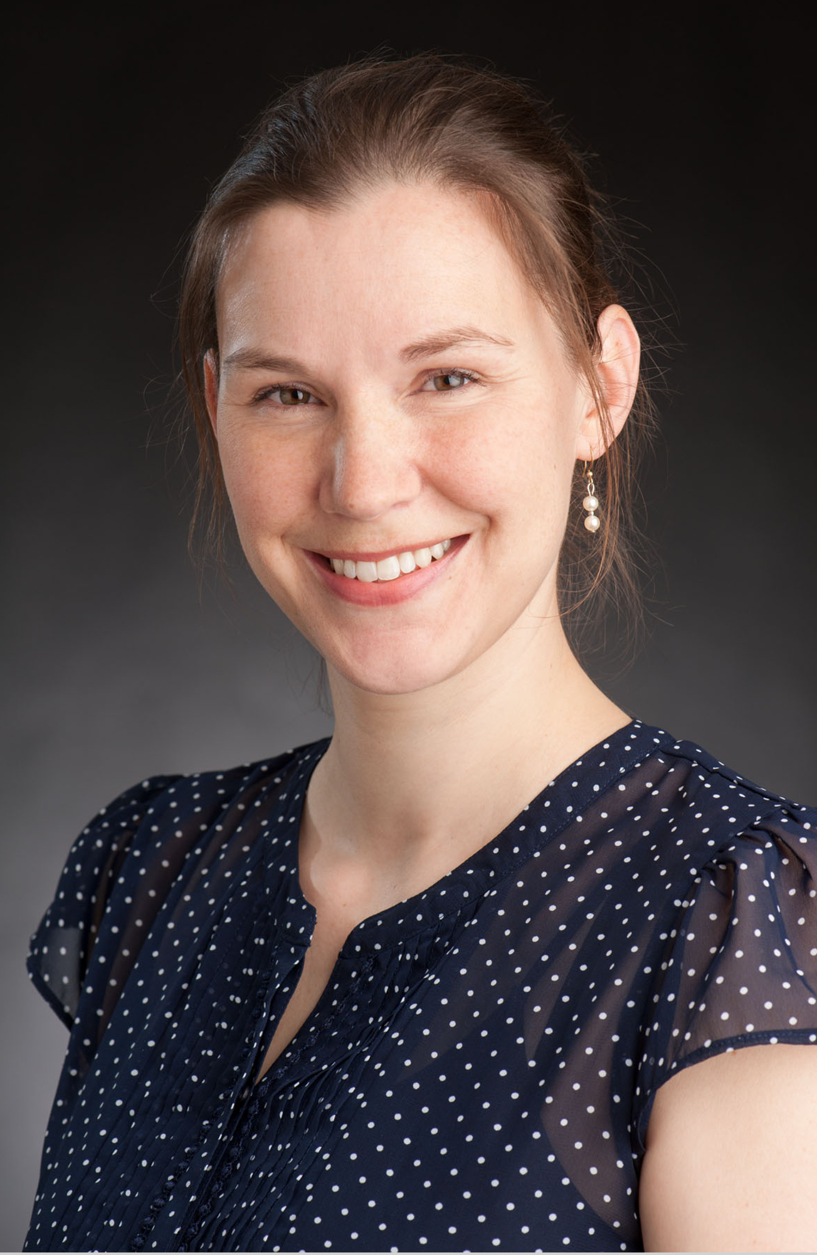

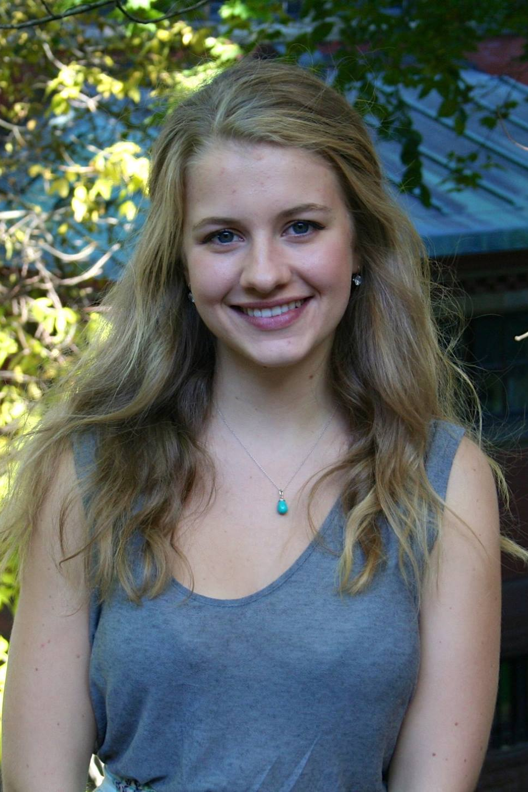
Acknowledgements (1)
Brett Thombs, PhD
Director of SPIN
Linda Kwakkenbos, PhD
Co-director of SPIN
Marie-Eve Carrier, MSc
Senior Research Coordinator
Kimberly Turner, BA
Research Assistant
Julie Cumin, BA
Research Assistant
Visit www.spinsclero.com for more information

Slide 38



Acknowledgements (2)
The Scleroderma Patient-centered Intervention Network has been funded by the Canadian Institutes of Health Research, the Scleroderma Society of Ontario, the Scleroderma Society of Canada, Sclérodermie Québec, the Lady Davis Institute of the Jewish General Hospital, and McGill University.

